Slide 1

Around the Table
AA Themes in Image & Metaphor
Around the Table: AA Themes in Image & Metaphor
by Jason Bresnehan
Emix. Plagiarize. Provoke. Grab ’em. Paste ’em. Reframe. Reclaim. Remix. Reuse. Reignite.
Swipe the visual. Hack the context. Own the narrative.
Drop it in. Dress it up. Make it yours. Make it loud.
From slide decks to street sermons—these images don’t whisper. They declare

Slide 2
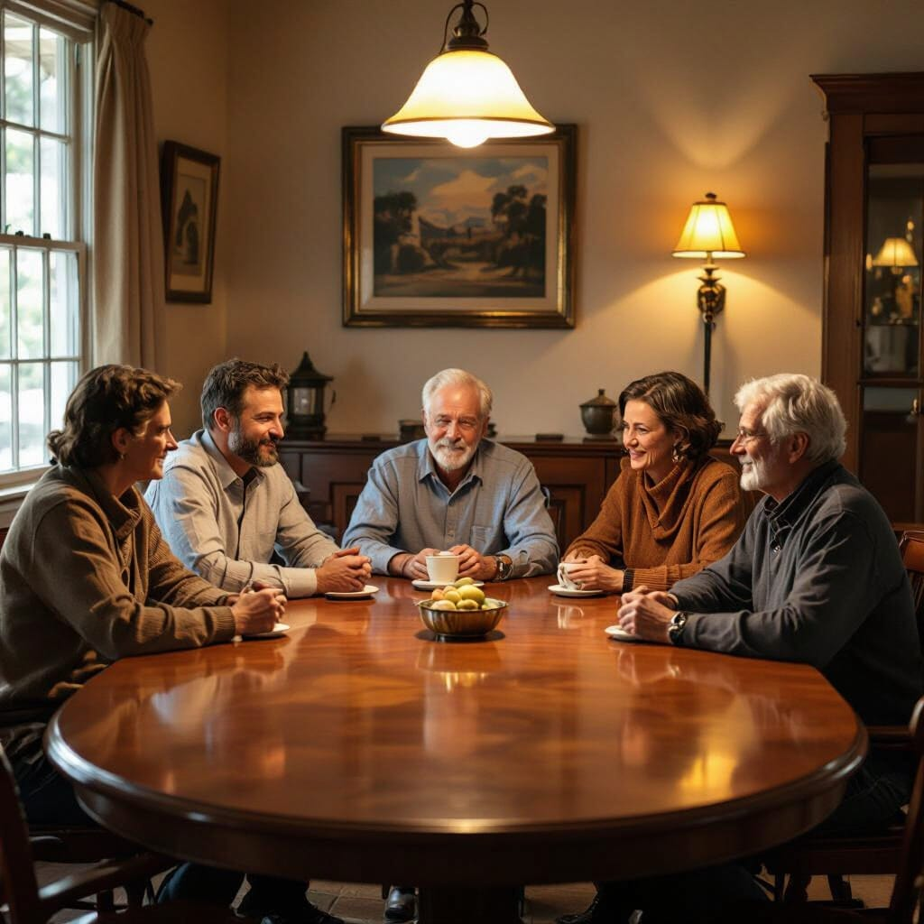
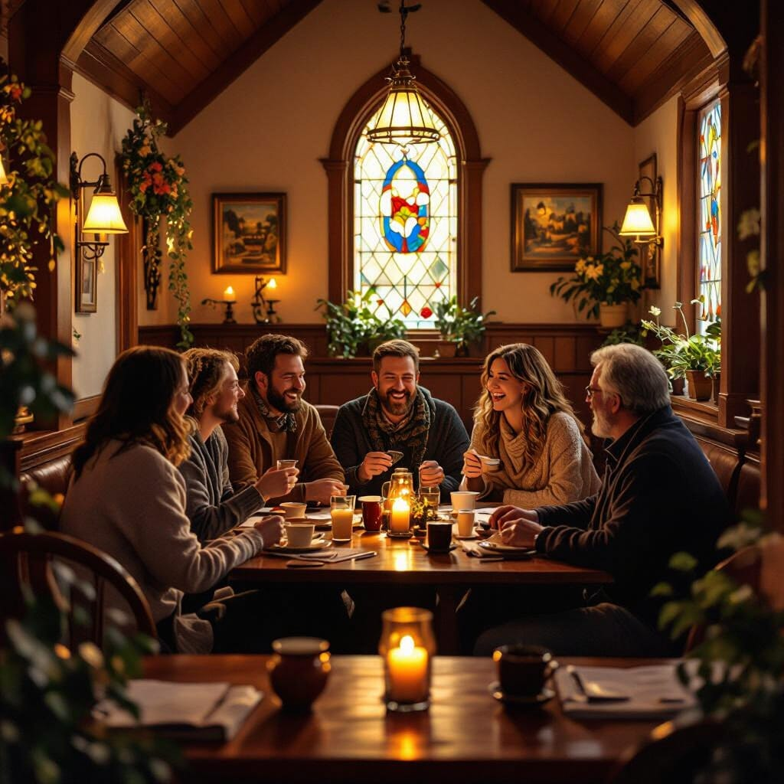

Slide 3



Slide 4
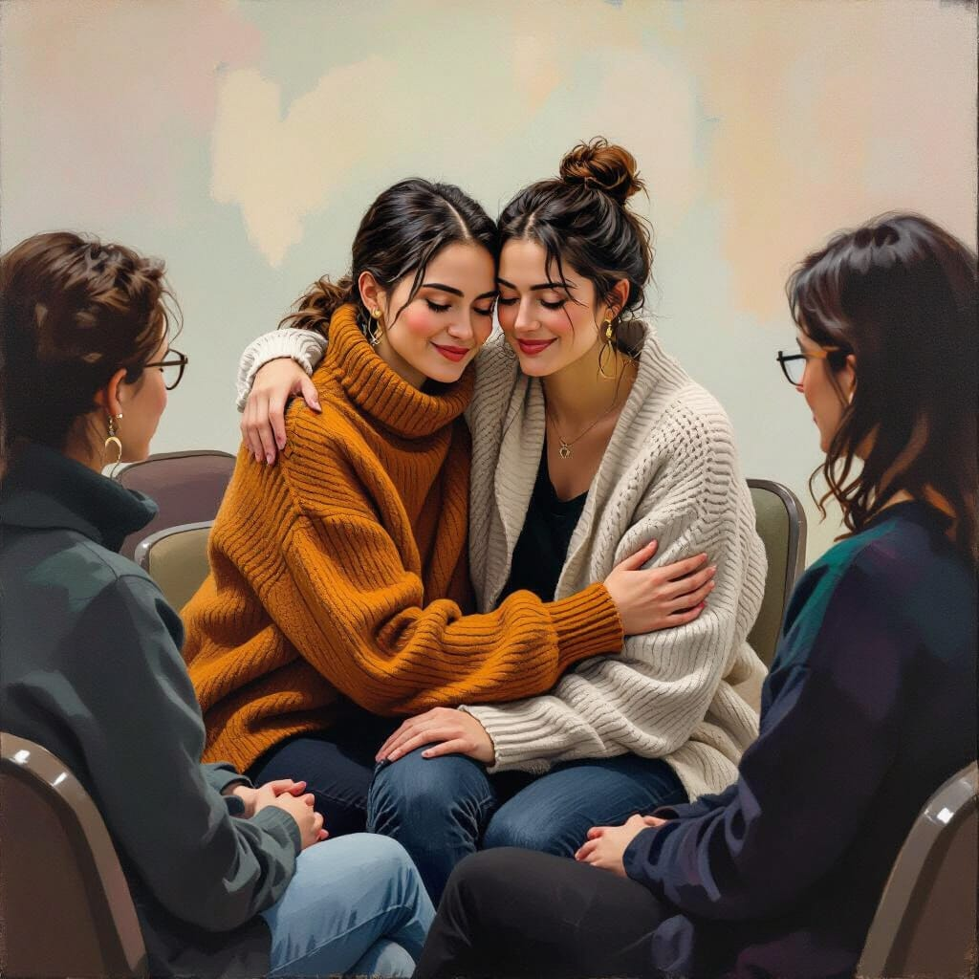
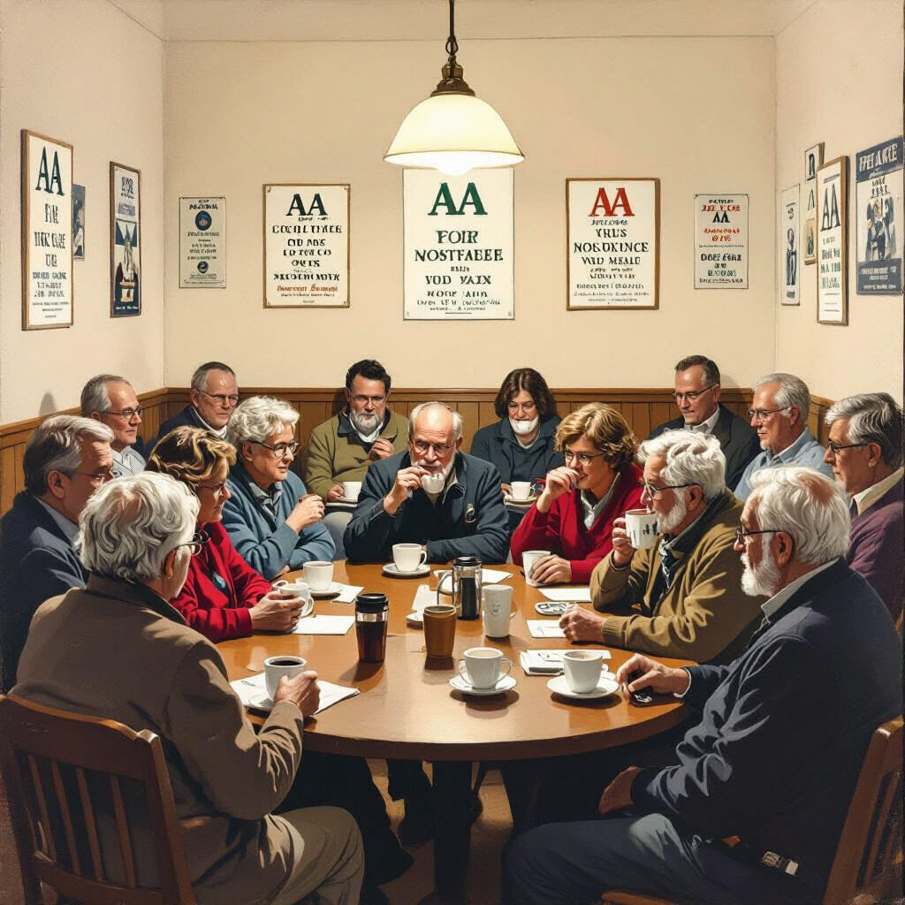

Slide 5
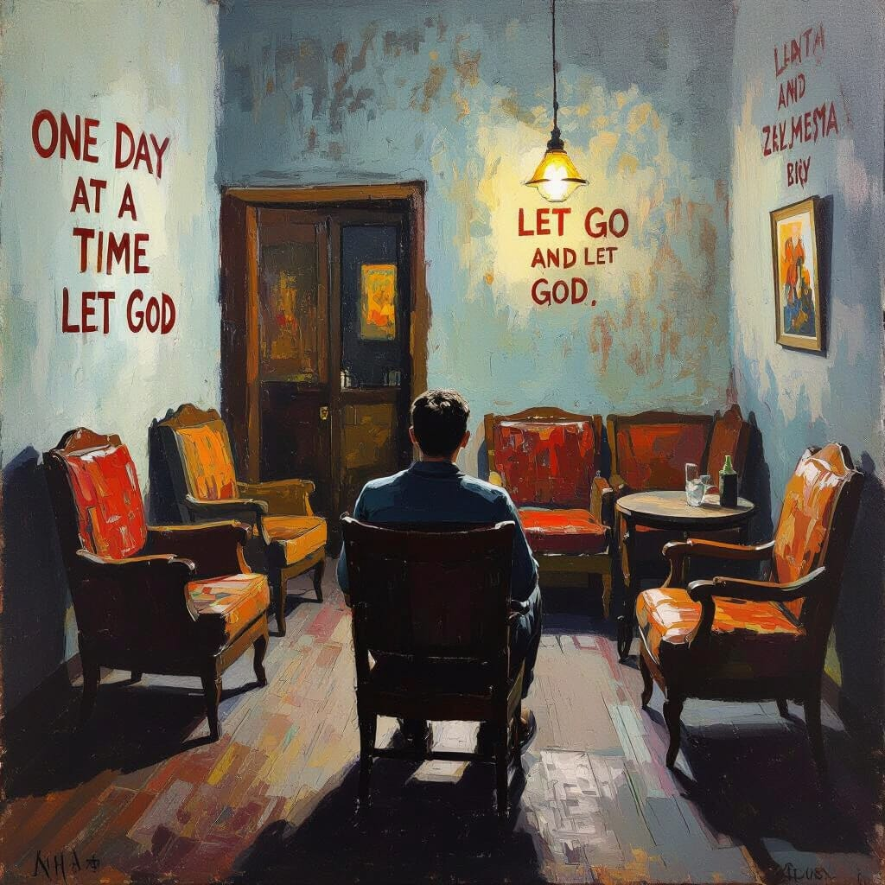


Slide 6
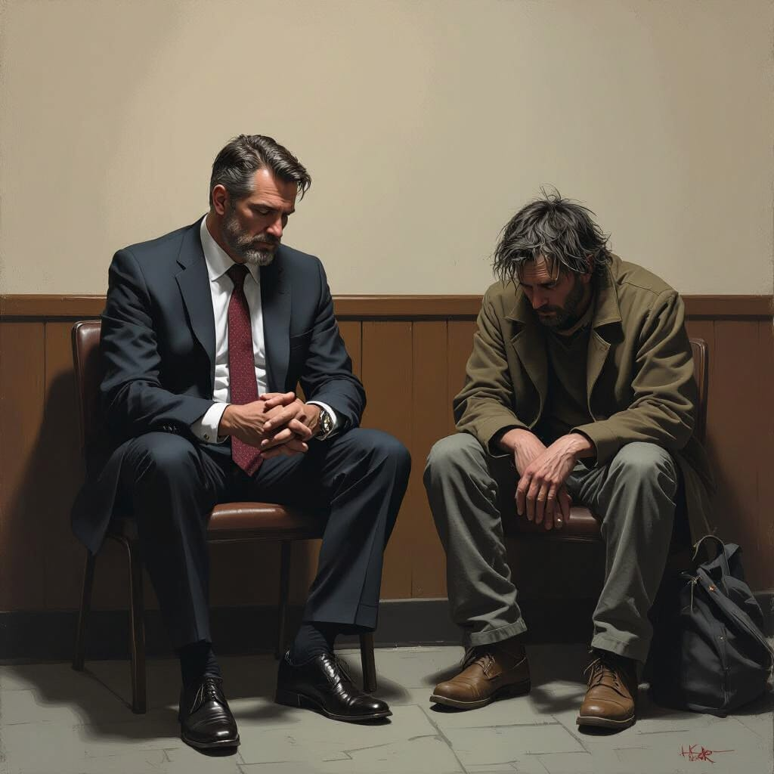
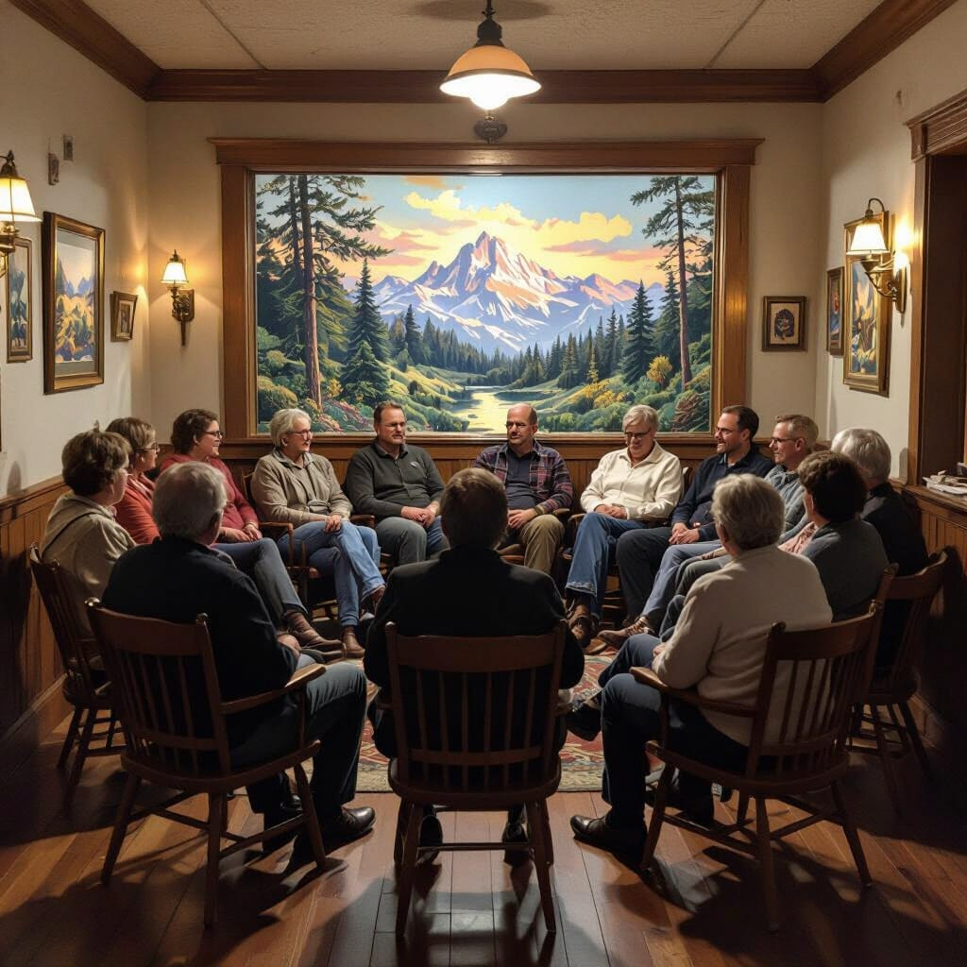

Slide 7
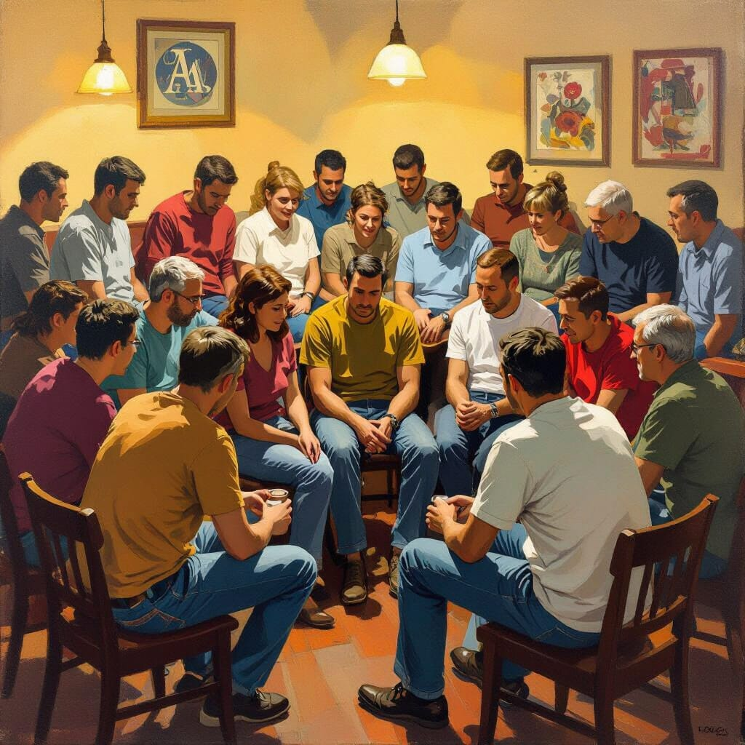


Slide 8



Slide 9

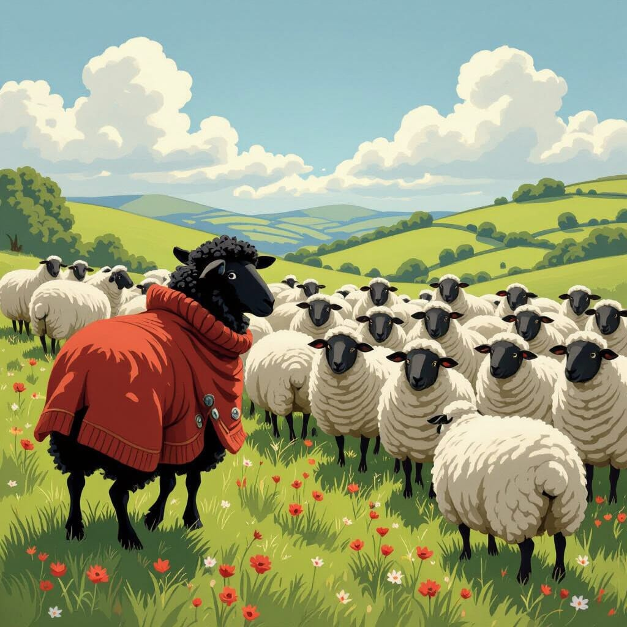

Slide 10
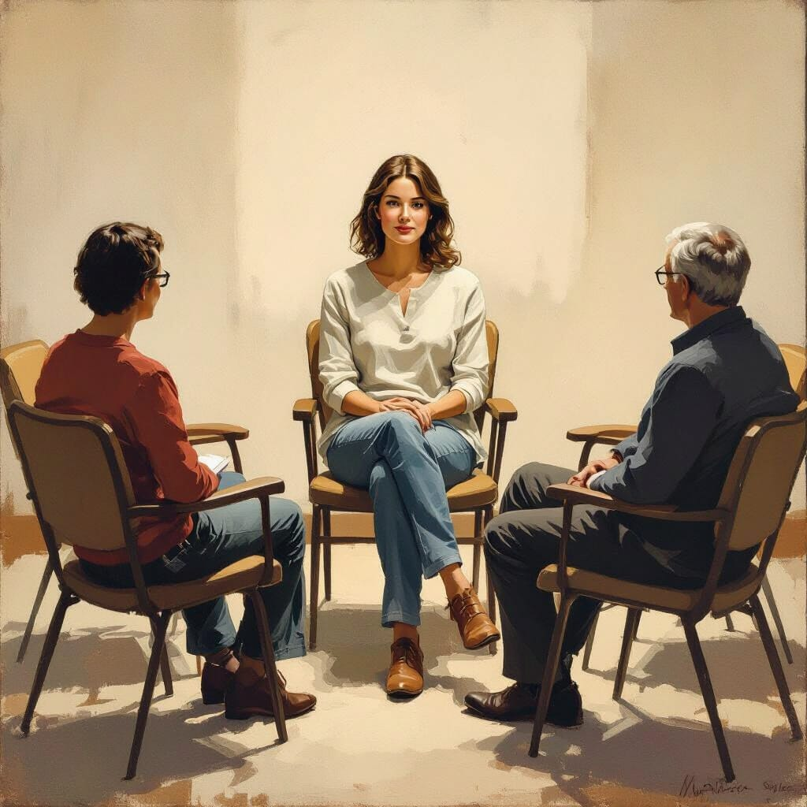
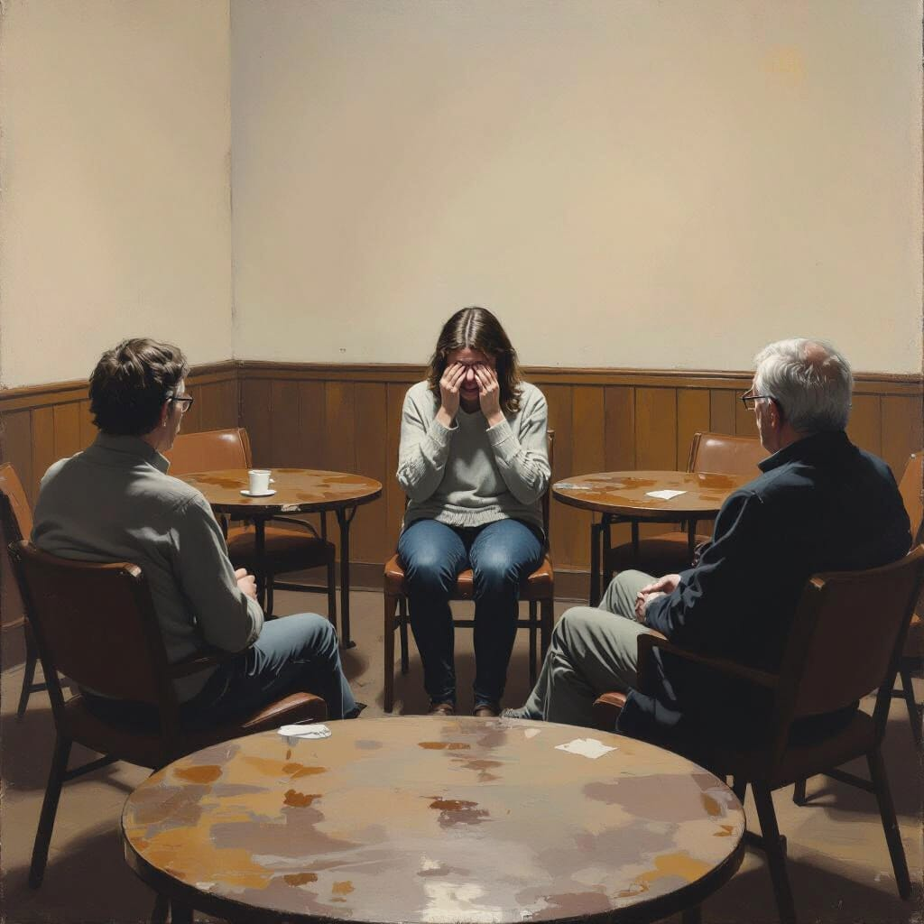

Slide 11



Slide 12
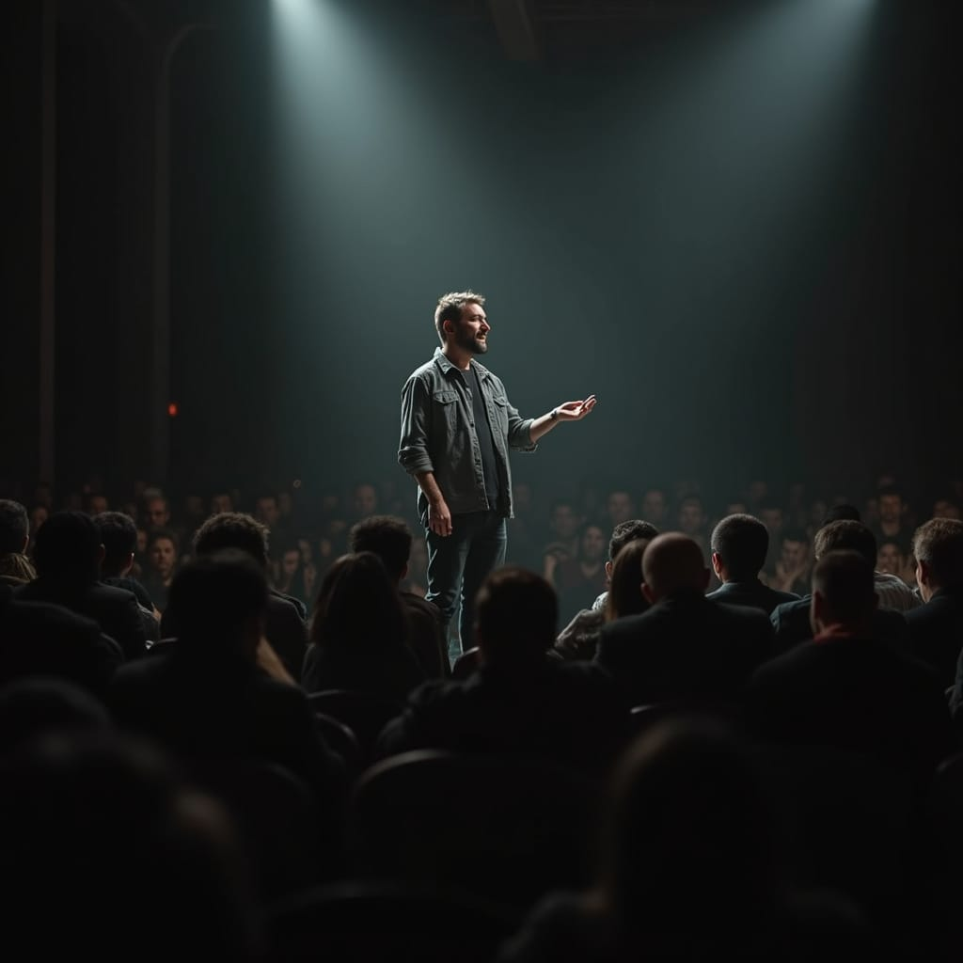


Slide 13
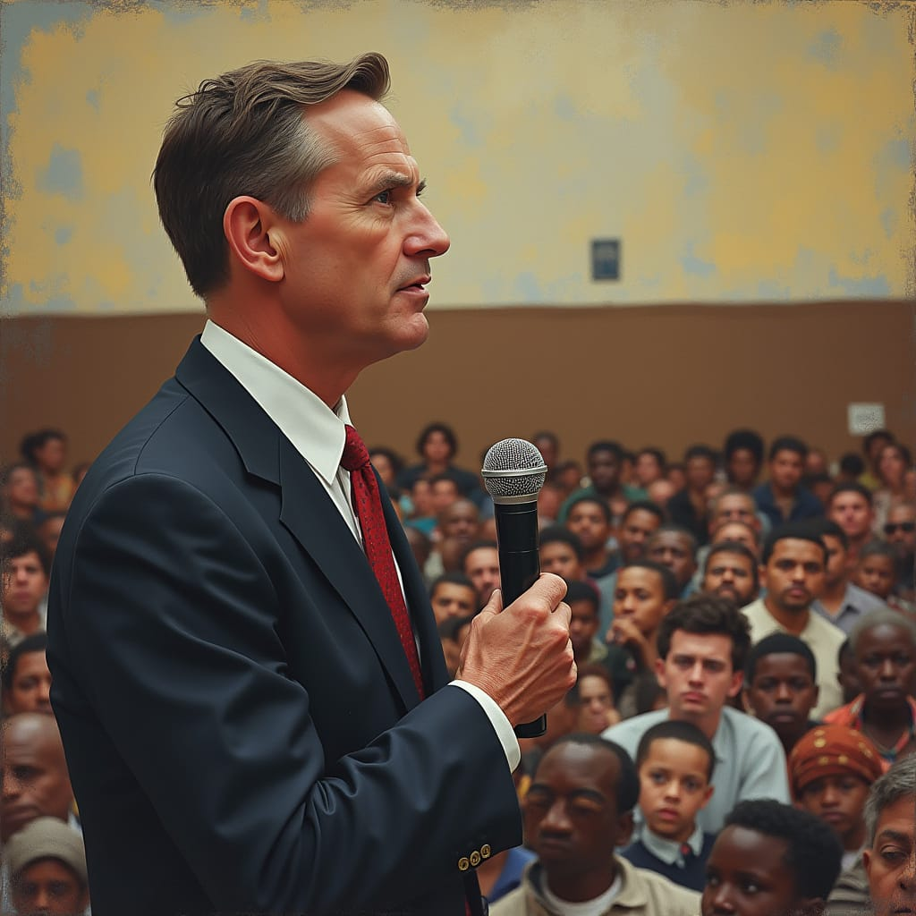


Slide 14

