Slide 1


Configured for Grace
An Alcohol Recovery Conversation
Thank you to both Lions Clubs for inviting me.
I’m not here with a script—I’m here with a lived story.
This is not a lecture. It’s a conversation about truth, trust, and transformation

Slide 2

The Scale of the Issue
~150 AA members northern Tas Easily ten times not in the rooms
Quick maths = 0.6% with a problem, 160,000 Australians quietly suffering
“Alcoholism isn’t just common—it’s prolific. Hidden in plain sight.”
Tasmania men and women, 18-85yo, ER doctors, nurses, disability support, concreters, builders, earthmoving, fabricators, industrial chemist, famers, ex-soldiers, electricians, painters, hairdressers, public servants financial advisers, consultants, lawyers, teachers, business owners and retirees

Slide 3
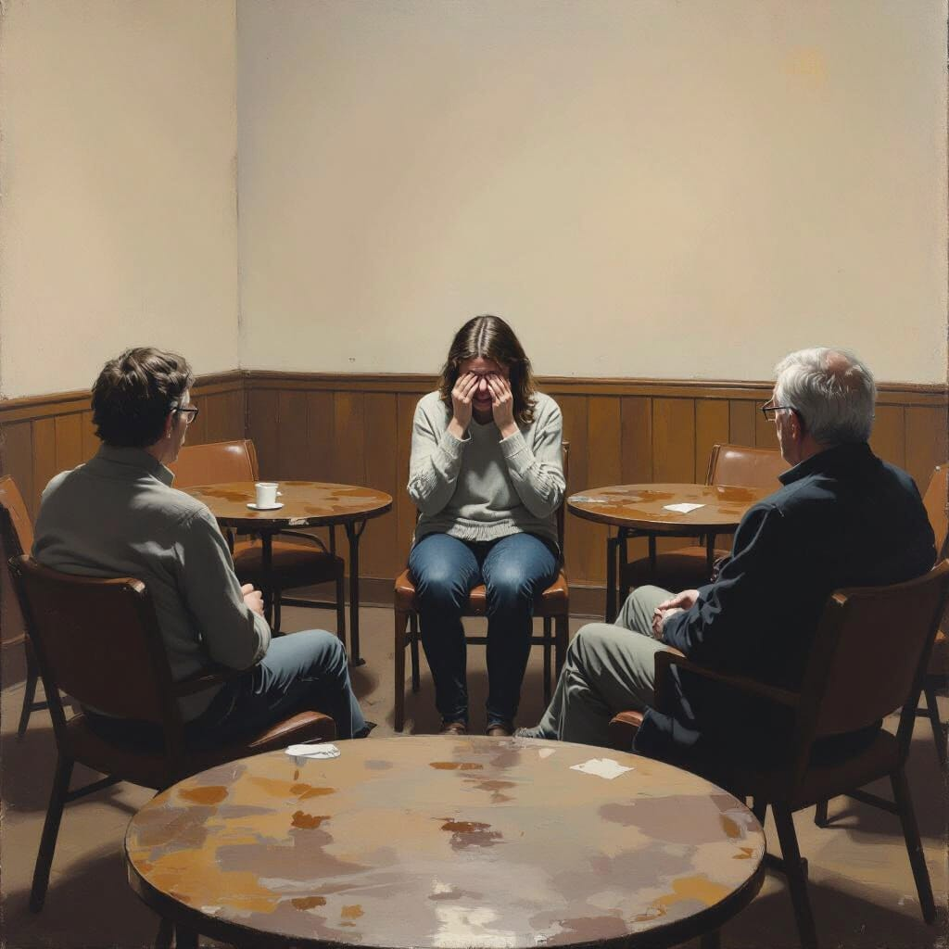
It’s a Disease
Will power has nothing to do with it . Recognised by the WHO. It’s
Spiritual
Mental
Genetic
It’s all of it
Neurological
Emotional
There is no magic pill - The Fix is Spiritual

Slide 4

The Adversary
Invisible conman, salesman, lawyer, trickster, dream painter, confidence builder, liar
We all have one
Chocolate ~ overeating ~ laziness ~ anger ~ always right ~ procrastinating
SUPERCHARGED & TURBOCHARGED
for addicts and alcoholics
That why the the Fix is Spiritual

Slide 5

What Makes an “Alcoholic”
An innocent start
Amount is irrelevant and there is no definition
When you here my story you will learn about:
Denial
Planning
Reinforcement from environment
Progression
Lies
More Denial
ROCK BOTTOM
Spiritual decline
You don’t have to diagnose. You just need to earn the trust of someone who needs help – they will self- diagnose

Slide 6
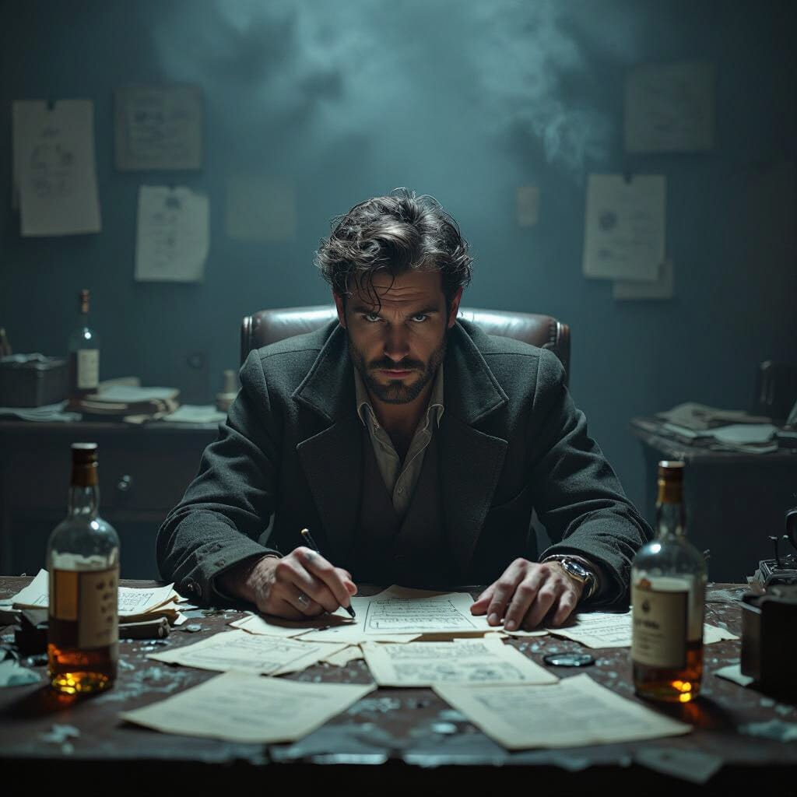
My Story
Hello, my name is Jason and I’m an Alcoholic
I’ve met three Johnnies in my life—Johnny Walker, Johnny Cashed Up, and Johnny Illinois. One numbed me. One masked me. One reminded me that grace is quiet, and healing begins when we stop performing and start listening

Slide 7
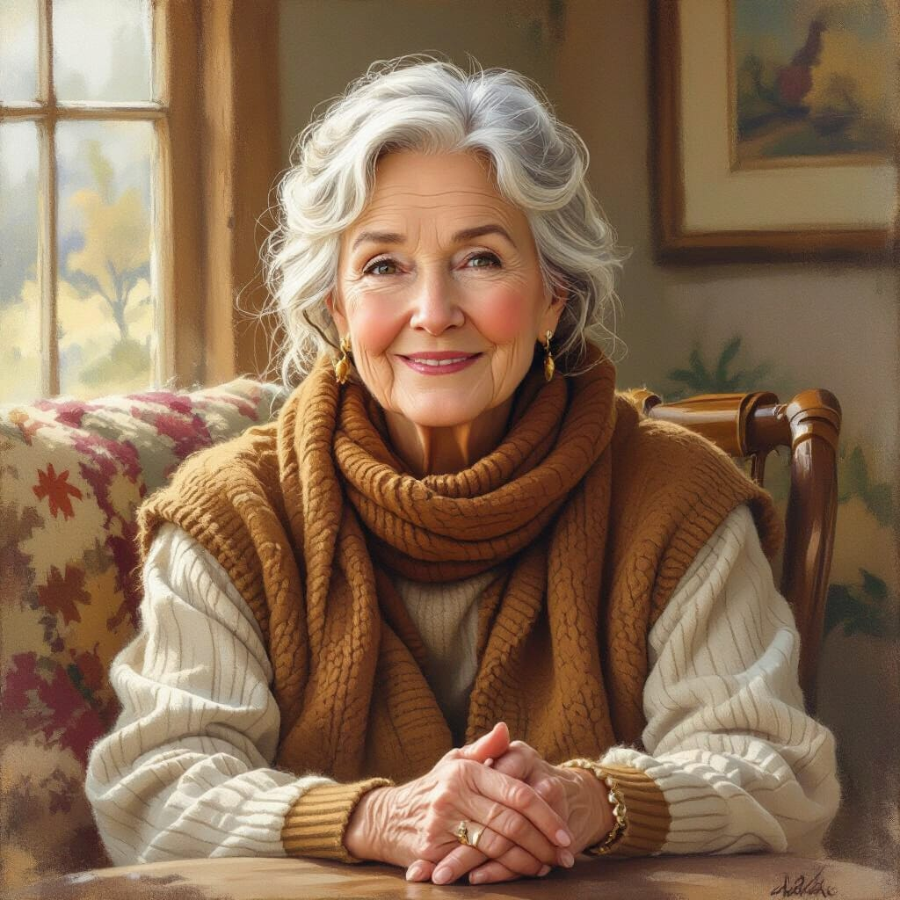
You are all Fixers
How do you help?
Offer to have a chat
Don’t judge – tell them you understand its a disease
Help them build their Support Team, talk to their father, mother, brother, sister, best friend
When a person comes into your orbit
You are kind people who are good listeners
Listen
Refer – Recovery is not a journey you can walk alone

Slide 8

Talk ~ Earn Trust ~ Refer
A desire to stop drinking
Call me – 0430 022 627
They need
A medical doctor
Call Lifeline
Call AA, Call Rehab
A willingness to admit that’s is a spiritual malady
Listen, learn, share
Understand themselves
Family and friends
Lots of Questions Please!

