Slide 1
Trinity Lens
A Lens to View the 12 Alcoholics Anonymous Steps
Step 1
Step 2
01
Powerlessness
Step 3
Step 5
Step 6
Step 7
Step 8
Step 9
Step 11
Step 12
03
02
Surrender
Inventory
Step 4
Step 10

Slide 2



01
1. Powerlessness
Accepting that you are powerless over alcohol—and that no amount of willpower or help from another human being can fix it.
Powerlessness
Step 1: We admitted we were powerless over alcohol—that our lives had become unmanageable.
Step 2: Came to believe that a Power greater than ourselves could restore us to sanity.
Sample Headline

Slide 3
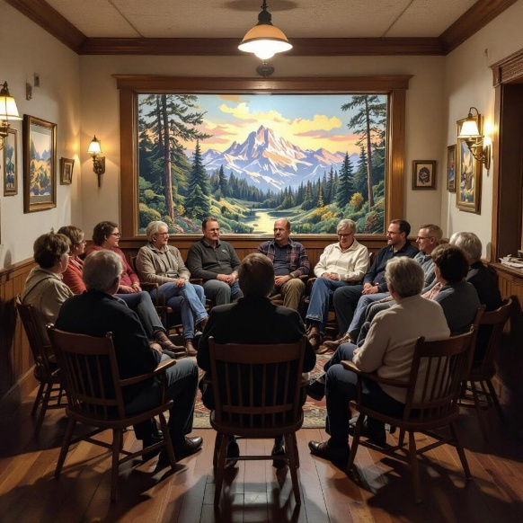
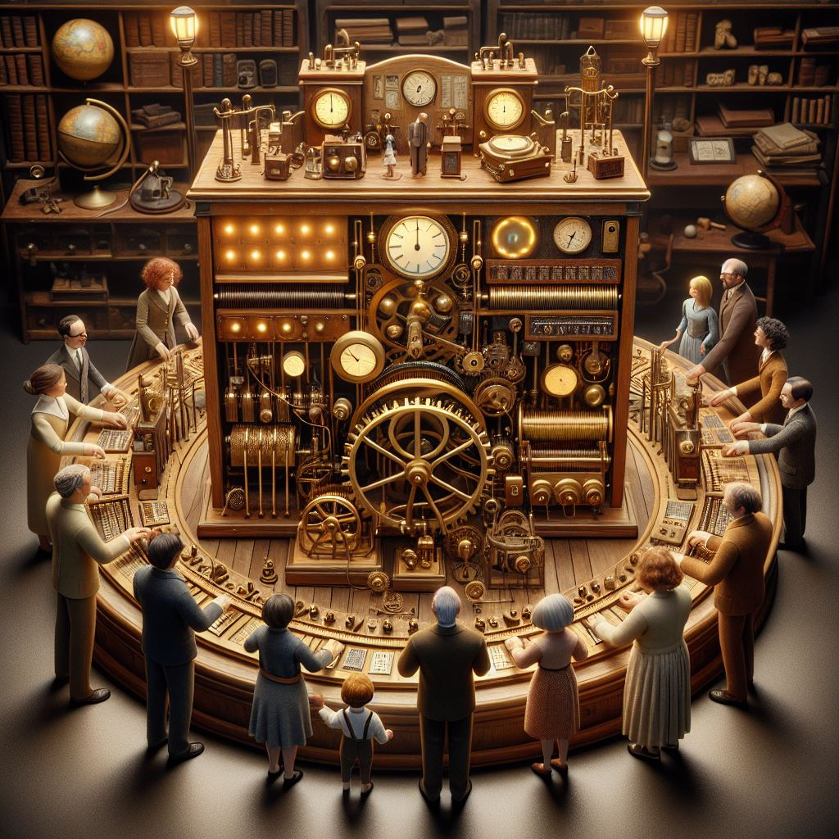
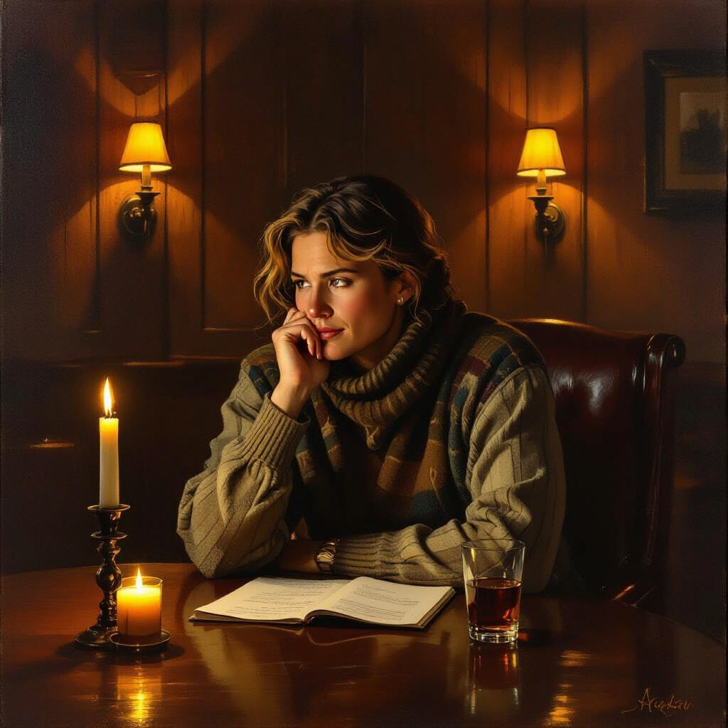
2. Inventory
You take inventory of your root-cause weaknesses—not just the justifications and excuses that alcohol once helped you mask. You take prayer-powered action to heal those weaknesses and build on your strengths.
Step 4: Made a searching and fearless moral inventory of ourselves.
Step 10: Continued to take personal inventory and when we were wrong promptly admitted it.
Sample Headline
02
Inventory

Slide 4

3. Surender
You turn your will and your life over to the care of God, accept the things you cannot change, find the courage to change the things you can, and seek the wisdom to know the difference.
03
01
Surender
Sample Headline
Step 3: Made a decision to turn our will and our lives over to the care of God as we understood Him.
Step 5: Admitted to God, to ourselves, and to another human being the exact nature of our wrongs.
Step 6: Were entirely ready to have God remove all these defects of character.
Step 7: Humbly asked Him to remove our shortcomings.
Step 8: Made a list of all persons we had harmed, and became willing to make amends to them all.
Step 9: Made direct amends to such people wherever possible, except when to do so would injure them or others.
Step 11: Sought through prayer and meditation to improve our conscious contact with God as we understood Him, praying only for knowledge of His will for us and the power to carry that out.
Step 12: Having had a spiritual awakening as the result of these steps, we tried to carry this message to alcoholics, and to practice these principles in all our affairs.
02
Sample Headline

Slide 5








